Slide 1
0x302 – Authentication
ECED4406 – Computer Security
Dr. Colin O’Flynn
Dalhousie University.

Slide 2
What are we authenticating?
Authenticating is proving who “someone” is:
Someone can be:
Human
Device
File
Firmware / Operating System
Update Data

Slide 3
What are we authenticating?
Thing we are authenticating: | Authentication Type
Human | Password / Secret
Device | Certificate
File | Signature
Firmware/OS | Secure boot process
Update Data | Signature Package

Slide 4
Human Authentication Factors
For humans we often consider different factors:
Something you know (passwords, PINs)
Something you have (smart card, phone)
Something you are (fingerprint, retinal scan)

Slide 5
Password Based Authentication

Slide 6
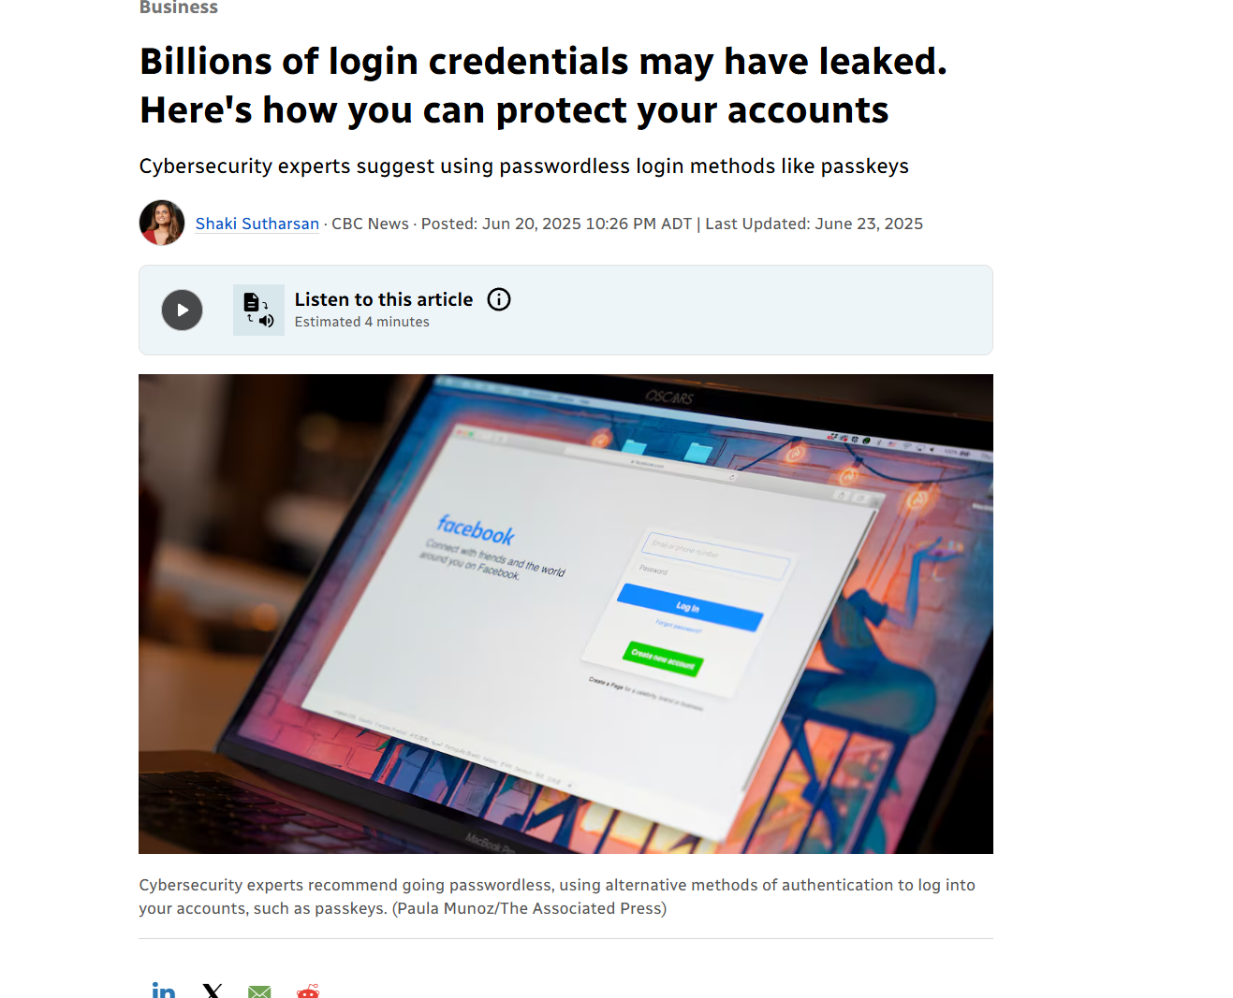
Password Storage
Passwords incorrectly stored are vulnerable to be leaked

Slide 7
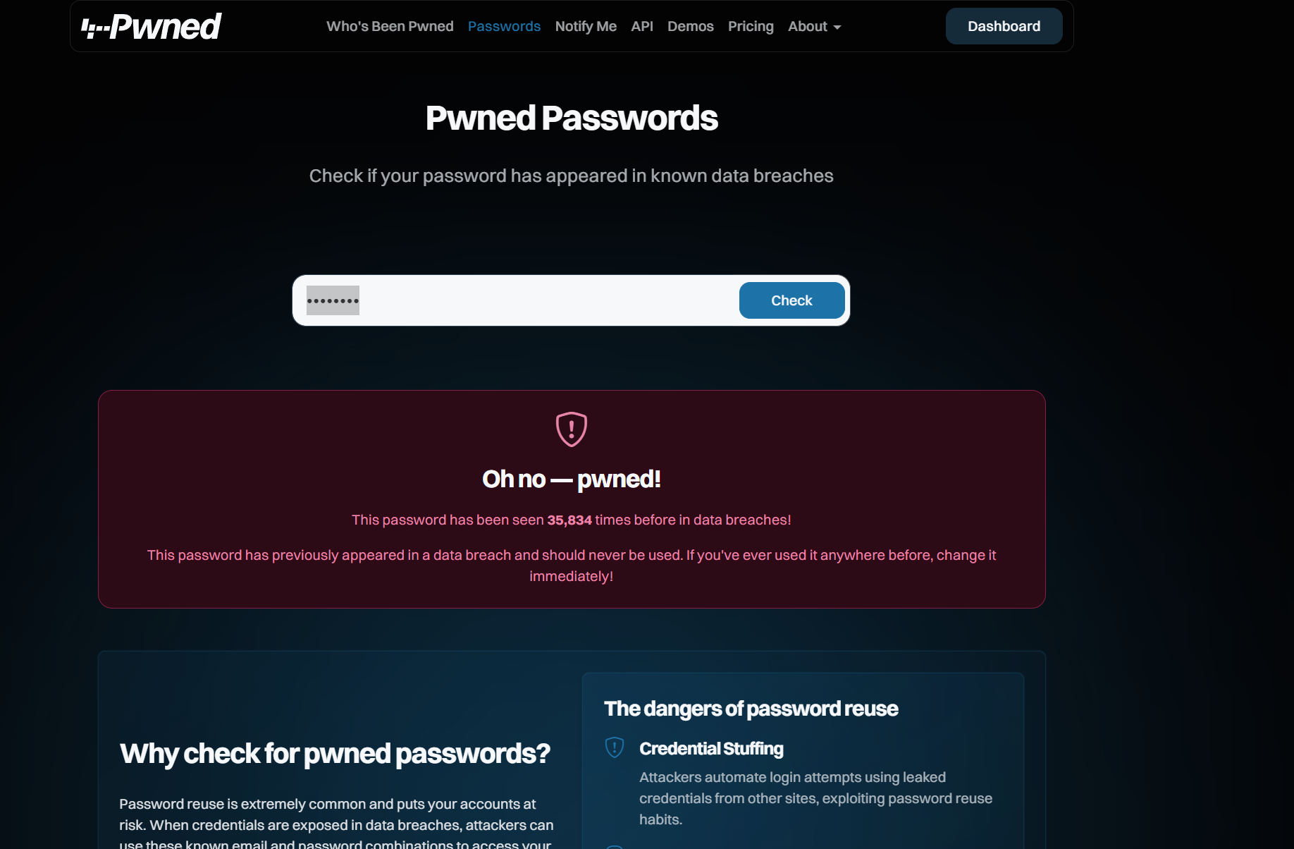
e.g., Checking Passwords
https://haveibeenpwned.com/Passwords

Slide 8
Password Storage Attempt #1
“password”
Hash Algorithm
5baa61e4c9b93f3f0682250b6cf8331b7ee68fd8
https://emn178.github.io/online-tools/sha1.html

Slide 9
Sidenotes: HEX / Base64
Hex Data
5baa61e4c9b93f3f0682250b6cf8331b7ee68fd8
Base64
W6ph5Mm5Pz8GgiULbPgzG37mj9g

Slide 10
Password Checking with Hashes
password
Stored password hash
Hash Algorithm
Comparison
Password hash
User Computer
Server

Slide 11
Attacks on Hashes
Calculating a password from a hash requires a brute force check.
This is difficult but not impossible for most peoples password complexity levels
We can speed this up with a Rainbow Table – a precalculated table of passwords that are hashed with the known algorithm.

Slide 12
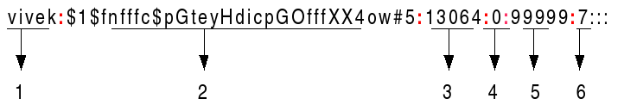
Preventing Rainbow Table Usage
(Almost) all modern systems storing passwords used salts with the hashes

Slide 13
e.g., Salt Example
sha1(“password”) = W6ph5Mm5Pz8GgiULbPgzG37mj9g=
sha1(“password+89273”) = 4hPn0mFSLzypoXYRZtexpGh15DY=
sha1(“password+93838”) = gti/NjLaiHF0IPMat/WB9qAmpPg=
https://emn178.github.io/online-tools/sha1.html

Slide 14
Password Checking with Salt+Hashes
password
Stored password salt
Stored password hash
Hash Algorithm with Salt Input
Comparison
Password hash
User Computer
Server

Slide 15
Salt Properties
The salt does not provide additional bits of security.
The salt does not prevent someone from brute-forcing your specific password.
The salt does prevent pre-calculation of your password from a leaked hash.
The salt is not a secret.

Slide 16
General Cryptographic Authentication
In cryptographic authentication, we will normally want to force knowledge of a secret key or shared secret.
There are several ways to force such knowledge.

Slide 17
Shared Key Example – Checking Random #

Slide 18
Shared Key Example – 2-Way Authentication

Slide 19
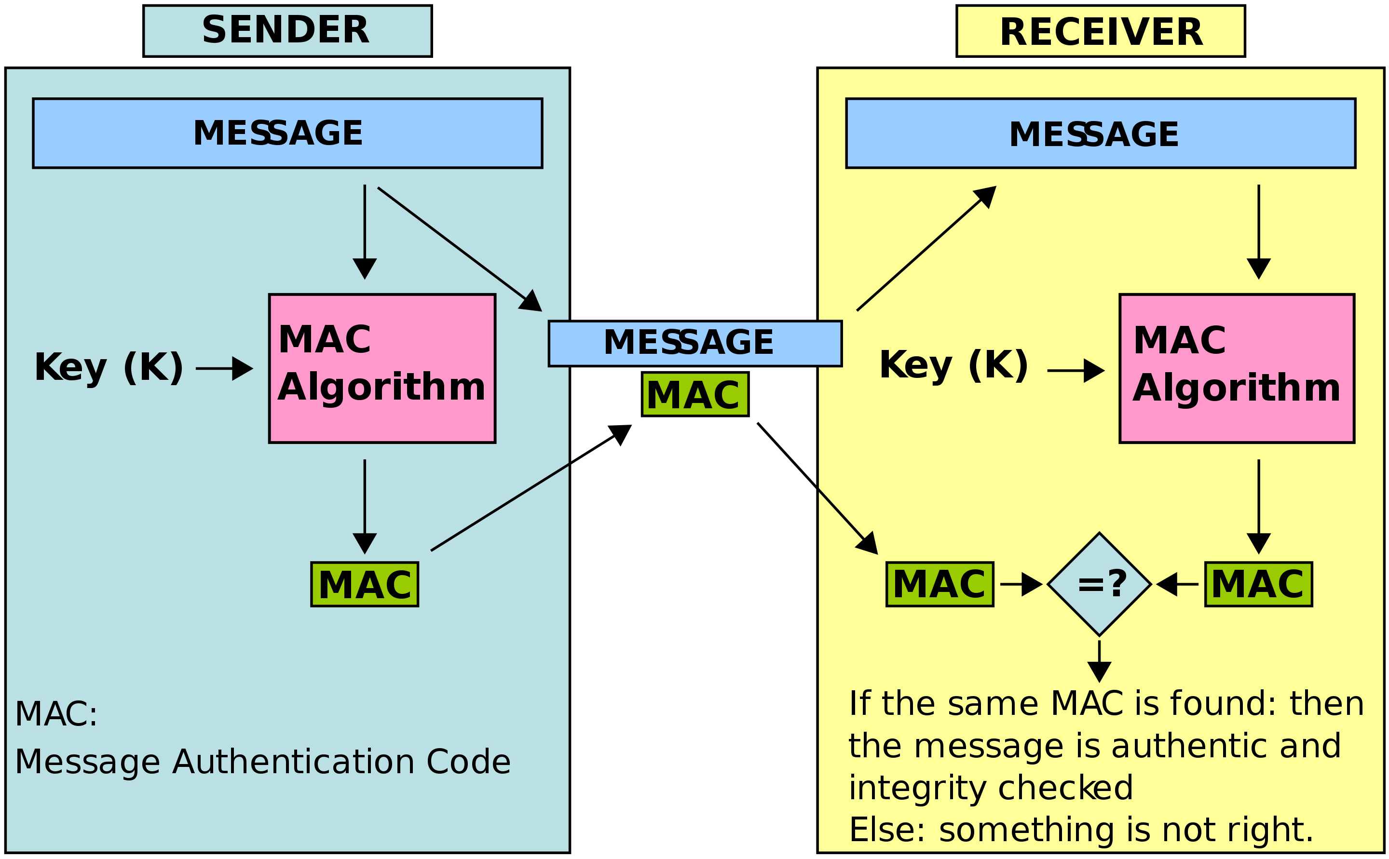
Message Authentication Code
https://en.wikipedia.org/wiki/Message_authentication_code#/media/File:MAC.svg

Slide 20
Public / Private Key Pairs
We’ll discuss some of these algorithms later, but for now:
Public key cryptography allows us to design algorithms with two keys:
One key is “private” and performs one operation (such as decryption).
The other key is “public” and performs another operation (such as encryption).
Knowing only the “public” key you cannot perform both operations.

Slide 21
E.g., Normal Public / Private Example
Encrypt Operation
Decrypt Operation
1238907
0xF00DBABE
1238907
Public Key
Private Key

Slide 22
E.g., Simple Public / Private Example
Decrypt Operation
0xF00DBABE
Public Key

Slide 23
Less Useful Public/Private Key Operation?
Encrypt Operation
Decrypt Operation
1238907
0xF00DBABE
1238907
Private Key
Public Key

Slide 24
Public / Private Key for Signing
Firmware File (500MB)
Internet (bad?)
Firmware File?

Slide 25
Public / Private Key for Signing
Firmware File (500MB)
Hash Function
Hash (2048 Bytes)
Encrypt Operation
Encrypted Hash (2048 Bytes)
Private Key

Slide 26
Public / Private Key for Signing
Firmware File (500MB)
Internet (bad?)
Firmware File?
Encrypted Hash (2048 Bytes)
Internet (better?)
Private Key

Slide 27
Less Useful Public/Private Key Operation?
Encrypt Operation
Decrypt Operation
1238907
0xF00DBABE
1238907
Private Key
Public Key

Slide 28
Public / Private Key for Signing
Firmware File (500MB)
Internet (bad?)
Firmware File?
Encrypted Hash (2048 Bytes)
Encrypted Hash ? (2048 Bytes)
Decrypt Operation
Internet (better?)
Private Key
Public Key
Decrypted Hash (2048 Bytes)

Slide 29
Public / Private Key for Signing
Firmware File?
Hash Function
Hash (2048 Bytes)
Decrypted Hash (2048 Bytes)

Slide 30
Summary of Steps
Hash the file/message.
Send an encrypted hash which is decrypted by the user.
Either using a shared key or public/private key pair
This gives the user an expected hash (the one the sender “authorized”).
The user can then calculate the acutal hash of the file/message.
If they match then the file was “signed” by someone with the private key in question.

Slide 31
Simple Example in Python using shared key (symmetric) encryption (AES)
The following link is left in the slides for reference – I'll show you this after the next slide set where I introduce AES:
https://colab.research.google.com/drive/1lTBrFC4JzItIIqCrVEvpVjlDIDsp6GU7?usp=sharing

Slide 32
Public Key Repositories??
How is the public key transmitted??
As this is public was sometimes simply broadcast (less likely to be intercepted), posted on websites, etc.
IoT devices may have preprogrammed manufacturer public keys (only trust firmware signed by this key).
On the internet we have chains of trust based on a root public key.

Slide 33
Authentication Summary
Authentication is a critical aspect of cryptographic solutions.
Combining authentication with integrity & confidentially provides us with a way of securely transmitting data, while trusting the source of the data, and that is has not been modified.

